Slide 1
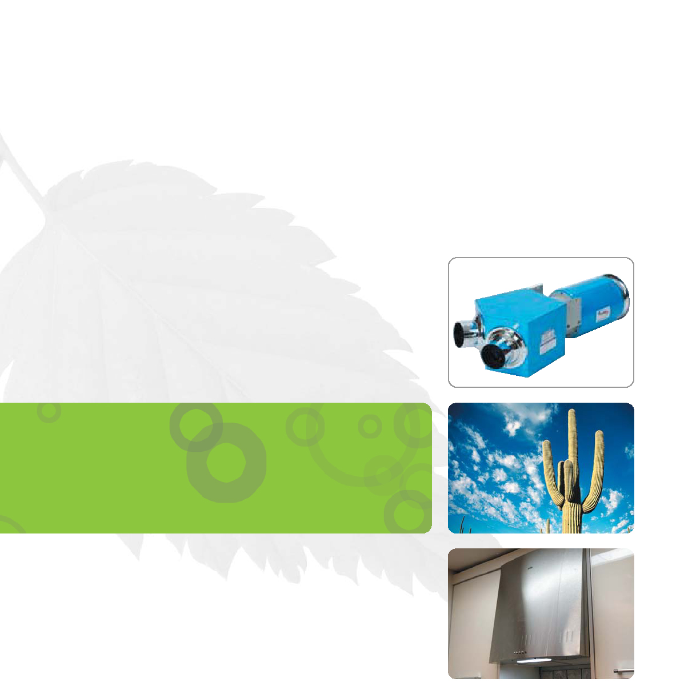
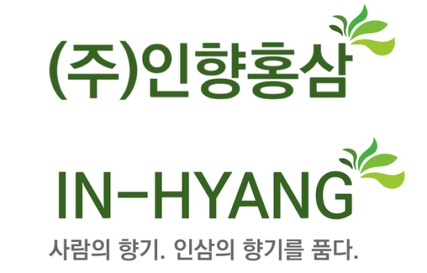
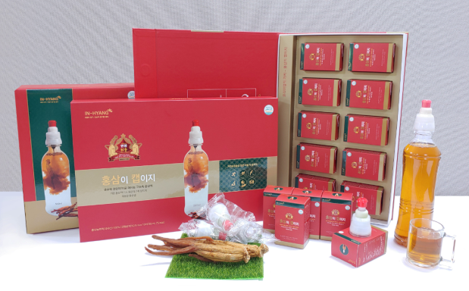
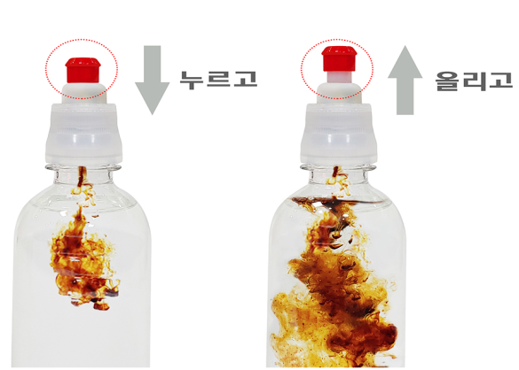
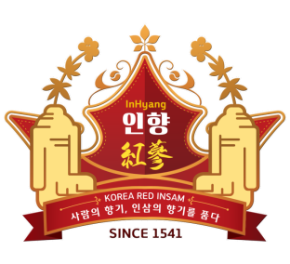
Qualification
Statement
Human Scent, Scent of Ginseng
https ://smartstore.naver.com/hongsamcap
/products/5121475771
http://blog.daum.net/okskpsm/5
Parc.1
INHYANG
[39870] #21-12 , Maewon3-gil ,Waegwan-eup, Chilgok-gun,Gyeongsangbuk-do ,
Republick of Korea
Tel: +82(0)54. 973.3277 Fax: +82(0)54. 974. 3277 / E-mail : okskcoh@hanmail.net

Slide 2

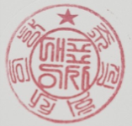

QUALIFICATION STATEMENT
INHYANG CORPORATION
Dear Sir,
This document is prepared by INHYANG to get assigned as a supplier of the Red Ginseng Concentrate Products Seller Company and the other Facility in invest project.
We look forward contribute in your Investment project ( production and sale) as the partner for Red ginseng Concentrate Product "CAP" and "Blister"
2020. 11 . 09 .
Lee Sang Gon / President
the best Red ginseng manufacturer
Made in Korea

Slide 3
Contents
Overview Introduction
Overview Company History
1. Information of the Company including Company’s documents
A. Certificate of Business Registration [English]
B. Certified copy of Corporate Registration [Korea]
1) List of shareholders
* Articles of Association
2) Certificate of Board Registration
C. Certificate of Doing Business Declaration (3 certificates)
1)Certificate of Health Functional Food Sales Business
2)Certificate of Distribution Sales Business
3)Certificate of Mail Order Business
D. Certificates of 3-Patent Rights and Laboratory
1) Certificate of Patent Registration (Cigarette type of Red Ginseng)
2) Certificate of Patent Registration (No-leftover Tube Container #1)
3) Certificate of Patent Registration (No-leftover Tube Container #2)
4) Certificate of Laboratory
E. Manufacturing Process Flow Chart
F. Business Organization Chart
G. Sum of required funds (Detailed breakdown is enclosed)
2. FUND Investment Contents (Summary)
[Total Amount of Investment Cost : USD30,000,000 ]
[Roi :3% / annually] / [ ten (10) years ]
A. Monthly Schedule from Facility Construction to start of product
Manufacturing
B. Breakdown of Expenses for Facilities
C. Breakdown of Working Capital
D. Yearly plan of loan repayment and interest payment
3. Fund for Factory Construction and Equipment
4. Explannation ginseng and Redginseng and Concentrate of Red ginseng
5.Plan to Purchase of raw materials or Concentrate of Red Ginseng
6. R&D Contents
7. Comparison of competitiveness between existing products and our products
8. Sales Plan
9. List of Enclosures
10. Product Manual of “Redginseng CAP”
INHYANG CORPORATION
1
Land for Redginseng Concentrate Extract Factory
2
Land for Ginseng Concentrate Filing and Container Development Factory
3
Land for Products’ container development factory
Made in Korea

Slide 4
Overview Introduction
Company Name/Address
INHYANG Corporation
Headquarter: [39870] 21-12, Maewon 3-gil , Waegwan-eup
,Chilgok-gun , Gyeongsangbuk-do, Republic
of Korea
Laboratory: 2F , 1938-2 , Sobaek-ro, Yeongju-si,
Gyeongsangbuk-do
President
INHYANG CORPORATION
Lee, Sang Gon
Contact/Fax
Headquarter : +82 54 973 3277 / Fax : +82 54 974 3277
Labortory : +82 54 972 7277
Homepage : www.inhyanghongsam.com
[Be preparing for the opening]
Blog : http://blog.daum.net/okskpsm
Smart Store
https://smartstore.naver.com/hongsamcap/
products/ 5121475771
E-mail : okskcoh@hanmail.net
Product Lists
Red ginseng CAP
Red ginseng Blister “CHEERS”
A tube without residual quantity Container
Red ginseng Concentrate type of cigarette
A tube without residual quantity Bottle

Slide 5
Overview Company History
2010 - 2016
Ginseng / Red ginseng , Operating Shop in Yeong Ju-si
2016 - 2018
Ginseng / Red ginseng / product research and development
Red ginseng CAP
Red ginseng Blister “CHEERS”
A tube without residual quantity Container
Red ginseng Concentrate type of cigarette
A tube without residual quantity Bottle
Patent Filing date (2018. March 30)
INHYANG CORPORATION
2019
Patent Registration date (2019. February 11)
Development of Red Ginseng-natural aging Concentrate
CAP Design / Product Design
Company establishment
Product production (OEM)
Export consultation(Russia , Vietnam)
Direct store opening (Yeongju city)
2020
Head office transfer (yeongju city => Chilgok-gun)
NH(NongHyub) Hanro-Mart Store Open
Made in Korea

Slide 6
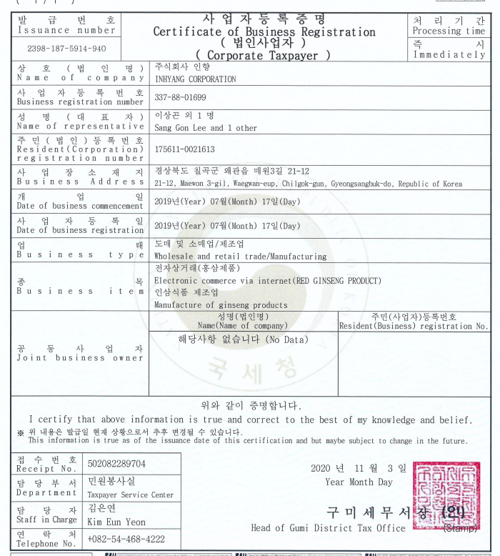
Company’s documents
A. Certificate of Business Registration[English]
INHYANG CORPORATION
Made in Korea

Slide 7
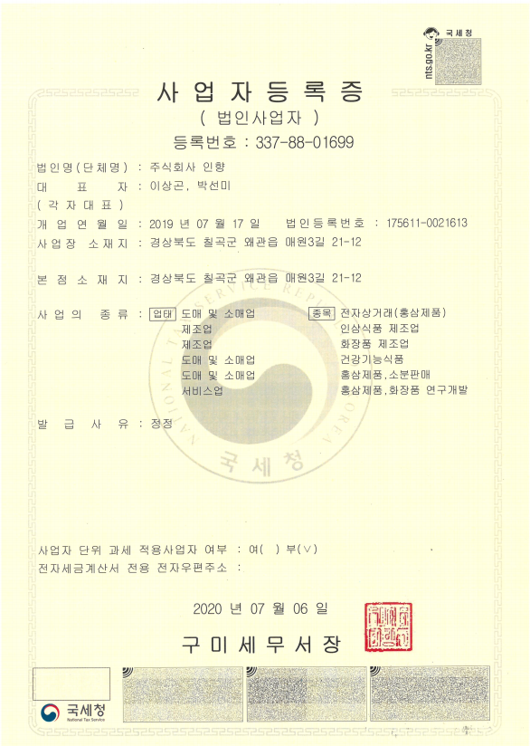
B. Certified copy of Corporate Registration
INHYANG CORPORATION
Made in Korea

Slide 8
B - 1) List of Shareholders
* Articles of Association [Enclosure]
Name of Shareholder | Korean Identification Number or Company Registration Number | Type of Shares | Number of Stocks | %
①Korea Red Ginseng Promotion Corporation | 308-82-72480 (Certificate of Proper Number) | Common | 100,000 | 33.34%
②Promotion Foundation of Bak-Gok-Jong-Hoe Branch of Gwangju Lee Family Clan | 220-82-64166 (Certificate of Proper Number) | Common | 100,000 | 33.34%
③Lee, Jong-min | 990518-1042315 | Common | 50,000 | 16.67%
④Lee, Jong-chang | 950805-1797824 | Common | 50,000 | 16.67%
Total |  |  | 300,000 | 100%
INHYANG CORPORATION
Par Value of A Share: ￦500 Korean Won (KRW)
Number of stocks: 300,000
Capital: ￦150,000,000 KRW ($132,744 USD)
We hereby certify that the above shareholders' list is exactly the same as the shareholders' list provided in the head office of the Company.
[relation manual ]
①Park seon mi (personal operation business registration certificate
/ Mr Lee Sang gon Wife.
②Lee Sang gon (personal operation business registration certificate
③Lee, Jong-min / Lee Sang gon(second son)
④Lee, jong-chan / Lee Sang gon(first son)
Made in Korea

Slide 9
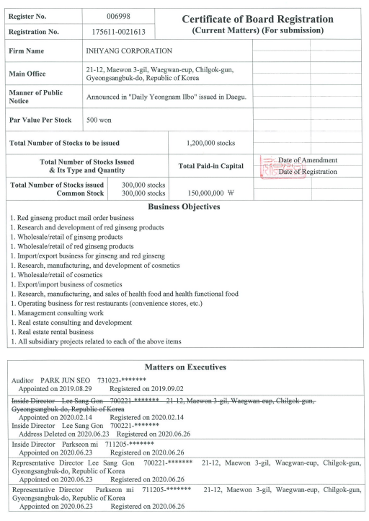
B - 2) Certification of Board Registration
INHYANG CORPORATION
Made in Korea

Slide 10
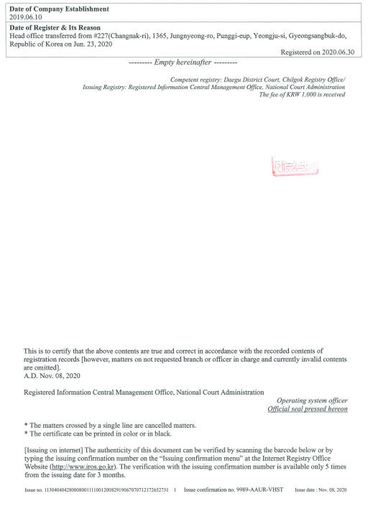
B - 2) Certification of Board Registration
INHYANG CORPORATION
Made in Korea

Slide 11
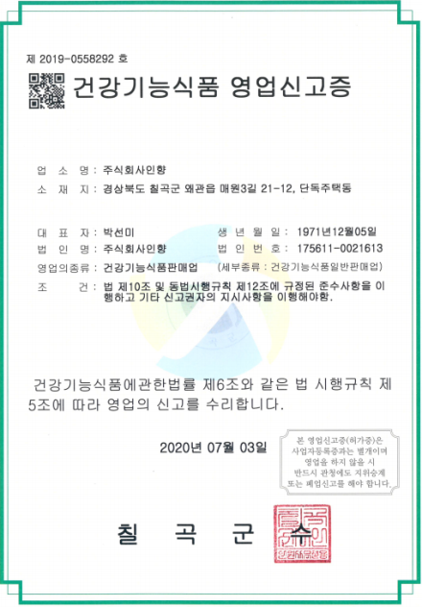
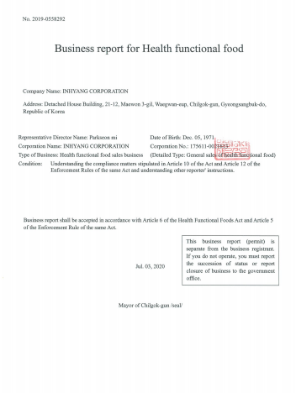
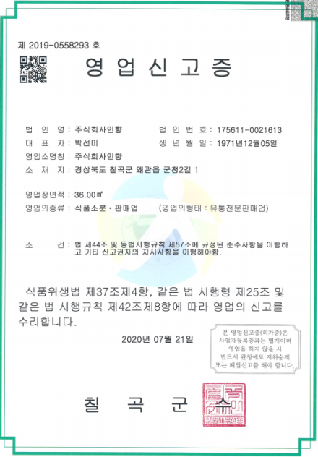
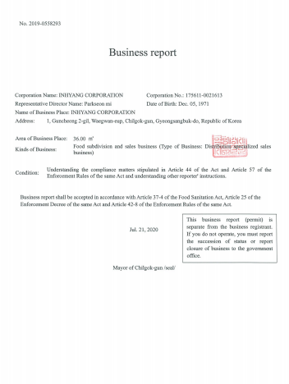
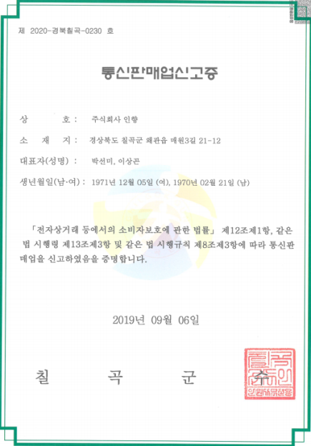
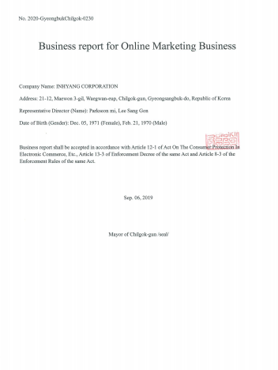
C. Certificate of Doing Business Declaration (3 certificates)
1)Certificate of Health Functional Food Sales Business
2)Certificate of Distribution Sales Business
3)Certificate of Mail Order Business
INHYANG CORPORATION
Made in Korea

Slide 12
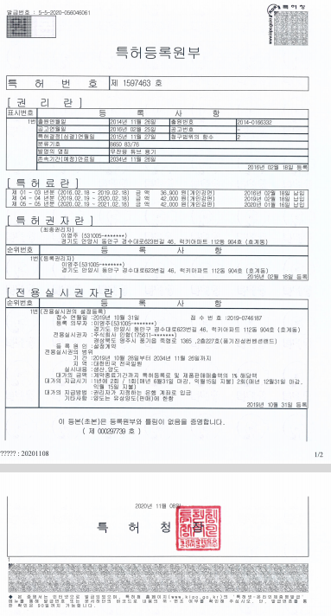
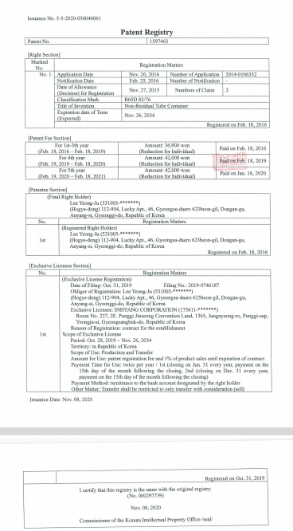
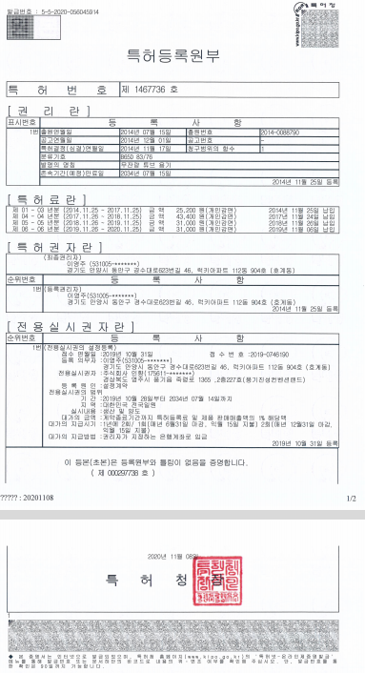
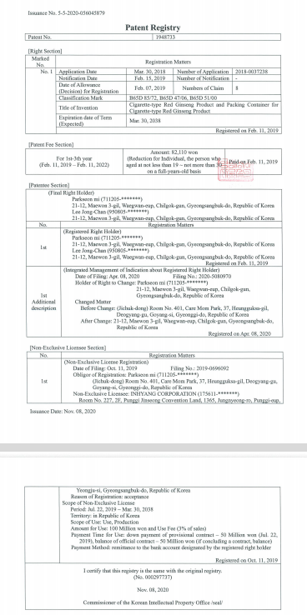
D. Certificates of 3-Patent Rights and Laboratory
1) Certificate of Patent Registration (Cigarette type of Red Ginseng)
2) Certificate of Patent Registration (No-leftover Tube Container #1)
3) Certificate of Patent Registration (No-leftover Tube Container #2)
4) Certificate of Laboratory
INHYANG CORPORATION
Made in Korea

Slide 13
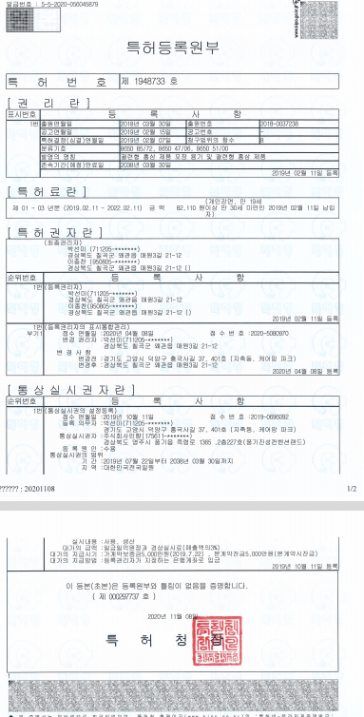
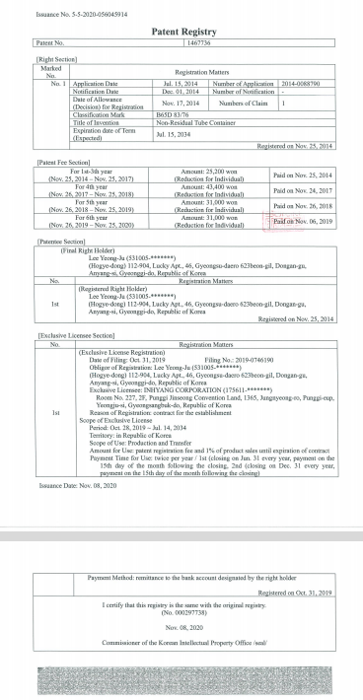
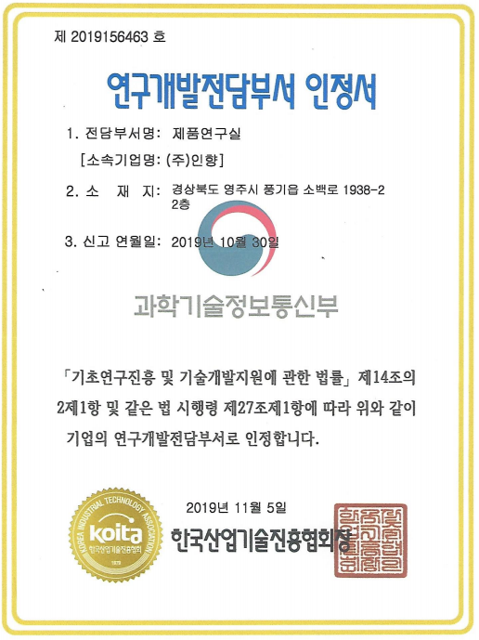
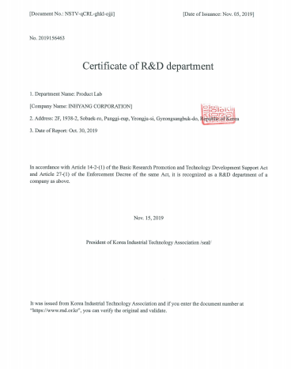
D. Certificates of 3-Patent Rights and Laboratory[English]
1) Certificate of Patent Registration (Cigarette type of Red Ginseng)
2) Certificate of Patent Registration (No-leftover Tube Container #1)
3) Certificate of Patent Registration (No-leftover Tube Container #2)
4) Certificate of Laboratory
INHYANG CORPORATION
Made in Korea

Slide 14
E. Manufacturing Process Flow Chart
④Contract farming of
6-year-old Ginseng
[ Factory for Red Ginseng Extract]
* Location of the Factory : [Pung-gi town, Gyeongbuk Province
Strength of the location
Origin of Ginseng or Red Ginseng,
①Purchase of 6-year-old Ginseng
⑤Washing and drying of
6-year-old Ginseng
⑥6-year-old Red Ginseng
②Purchase of 6-year-old Red Ginseng
⑦Raw material (Red Ginseng) Concentrate (Extract Process)
INHYANG CORPORATION
(2) (GMP) (HACCP): Factory for Red Ginseng Products Processing
* Location of the Factory: Chilgok County, Gyeongbuk Province
Strength of the location
Developed Distribution Network
③Self-manufacturing or purchase of product container
ⓐ (Red Ginseng Cap) (Receive Filling Machine)
ⓑ (Red Ginseng Blister Pack)
(Receive Filling machine
ⓒ (Red Ginseng Concentrate)
(No-leftover Tube Container)
(3) Factory for manufacturing of product container
* Location of the Factory: Chilgok County, Gyeongbuk Province
Strength of the location
Developed Distribution Network
ⓓPackaging Finished Product of Red Ginseng
ⓔStoring products
Made in Korea

Slide 15
F. Business Organization Chart
General
Chief Executive Officer
R&D Laboratory
Board of Directors
Auditor
Director of Research Institute
General Affairs
Production
Management
INHYANG CORPORATION
Product Planning Team
Product Development Team
Management Team
Management
Sale
Management
Product Team
Accounting
Sale Planing
Product
Support Team
Personnel/
Labor
Domestic
Business
Production
Team #1
Government
Relation
Oversea
Business
Production
Team #2
Production
Team #3
Production Plant for
two types of Cap[#1]
Production Plant for Container[#2]
Production Plant for
Red ginseng liquid[#3]
Made in Korea

Slide 16
G . Sum of required Funds
The total amount of required funds for the whole investment
Category | Breakdown | Amount (USD) | Note
(1)Land Purchase | Ⅰ.Concentrate Factory Ⅱ.Filling Factory Ⅲ.Container Development Factory | 2,637,562 | Ⅰ.(1,652.9m2) Ⅱ.(3,3058m2) Ⅲ.(3,3058m2)
(2)Construction Expenses | Ⅰ.Concentrate Factory Ⅱ.Filling Factory Ⅲ.Container Development Factory Ⅳ.Authorization/Permit Expenses | 4,567,032 | 4,425＄ $1,338.5/m2 (Certified GMP Facility)
(3)Machinery and Equipment Expenses | Ⅰ.Concentrate Factory Ⅱ.Filling Factory Ⅲ.Container Development Factory | 5,522,718 | Certified GMP + HACCP Facilities
(4)Working Capital |  | 7,296,460 | See details
(5)R&D Expenses | New Product Development, Patent Acquisition | R&D Expenses are included to Working Capital | See details
(6)Raw Material | Red ginseong Purchase Cost | 10,000,000 | -Ginseong Purchase Cost -Dried Ginseong Purchase Cost
Total |  | USD 30,023,772
INHYANG CORPORATION
Made in Korea

Slide 17
2. FUND Investment Contents (Summary)
A. Monthly Schedule from Facility Construction to Star of Product
Manufacturing
=> 12months from Land Purchase to Product Manufacturing
=> Land purchase time is important (A lot of problems could take place in winter
months)
Category | D+ 1(M) | D+ 2(M) | D+ 3(M) | D+ 4(M) | D+ 5(M) | D+ 6(M) | D+ 7(M) | D+ 8(M) | D+ 9(M) | D+ 10(M) | D+ 11(M) | D+ 12(M) | Note
Land Purchase |  | ●
Design |  | ●
Authorization /Permit |  | ●
Start of Construction |  |  | ●
Completion of Construction |  |  |  |  |  |  |  |  |  | ●
Facility Design |  | ●
Ordering of Facility |  | ●
Completion of Facility |  |  |  |  |  |  |  |  |  | ●
Red-Ginseng Concentrate Purchase |  |  |  | ● |  |  | ● |  |  | ●
Container Production |  |  |  |  |  |  |  |  |  | ●
New Product Development |  |  |  |  |  |  |  |  |  | ●
Design Development |  |  |  | ●
Development of Package |  |  |  |  |  |  |  |  | ●
Operational Testing |  |  |  |  |  |  |  |  |  |  | ●
Product Manufacturing |  |  |  |  |  |  |  |  |  |  |  | ●
Patent Application
INHYANG CORPORATION
Made in Korea

Slide 18
B. Breakdown of Expenses for Facilities (USD)
Category | Breakdown | Expenses | Note
Factory for Concentrate | Land Purchase | 442,478 | 1,650m2 (Ginseng Food Industrial Complex, Yeongju City, Gyeongbuk Province)
 | Acquisition Tax | 20,354
 | Construction Expenses | 2,212,389 | 1,650m2 for GMP, HACCP Facilities (Construction cost: $1.339 per 1m2)
 | Design & Authorization/ Permit Expenses | 88,496 | -
 | Machinery and Equipment Expenses | 2,205,681
 | VAT | 220,568
 | Subtotal | USD 5,189,966
2. Factory for Filling | Land Purchase | 1,106,195 | 3,305m2 (Gumi 3 Industrial Complex, Chilgok County, Gyeongbuk Province)
 | Acquisition Tax | 50,885
 | Construction Expenses | 1,327,434 | 991.74m2 for GMP, HACCP Facilties ($1,339 per 1m2)
 | Authorization/Permit Expenses | 88,496
 | Machinery and Equipment Expenses | 1,930,088
 | VAT | 193,009
 | Subtotal | USD 4,696,106
3. Factory for Container Development | Land Purchase | 973,451 | 3,305m2 (Machine Industrial Complex, A-gok Village, Chilgok County , Gyeongbuk Province)
 | Acquisition Tax | 44,779
 | Construction Expenses | 761,062 | 661m2 for GMP, HACCP Facilities ($1,152 per 1m2)
 | Design & Authorization/ Permit Expenses | 88,496
 | Machinery and Equipment Expenses | 884,956
 | VAT | 88,496
 | Subtotal | USD 2,841,239
Total |  | USD 12,727,319
INHYANG CORPORATION
Made in Korea

Slide 19
C. Breakdown of Working Capital (USD)
Category | Quantity | Required Expenses | Note
“Expansion of Market and Sales (Home/Abroad Market Development)” through an outsourcing until completion of self-production facility
Red Ginseng Bottle Cap Manufacturing | 2,000,000ea | 619,469
Red Ginseng Blister Pack Manufacturing | 2,000,000ea | 530,973
product packing preparation | 3,000,000ea | 1,592,920
Red Ginseng Concentrate Purchase | Each 10T | 2,477,876 | * Red Ginseng Bottle Cap (10T / USD1,238,938) , * Red Ginseng Bottle Cheers Blister Pack (10T / USD1,238,938)
Labor Cost | 20personnel | 411,504 | 3moths
R&D Expenses (1-5 : total) | 5 items described below | 513,274
1.Fermented Concentrate | (5months) | 88,496
2.Wild-Ginseng Culture Fluid | (5months) | 176,991
3.Making 2 types of cap | (5months) | 123,894
4.Making Blister Pack | (5months) | 61,947
5.Making No- leftover Tube Container | (5months) | 61,947
Reserve Funds (Various Fees) | Construction/ Facilities/ Operation/Fees | 884,956
Vehicles and Transportation Equipment | 5 Vehicles | 265,487
Raw materials | Red ginseng Purchase cost | 10,000,000 | Red Ginseng purchase cost , or Concentrate Red ginseng purchase cost Purchase at least (eight-ten months)
Total |  | USD 17,296,459
INHYANG CORPORATION
Made in Korea

Slide 20
D. Yearly plan of loan repayment and interest payment
Repayment through creation of operating Income
(1-year grace, 10-year installments / Every December installments)
Categor (y) | D+ 1(Y) | D+ 2(Y) |  | D+ 3(Y) |  | D+ 4(Y) |  | D+ 5(Y) |  | D+ 6(Y) |  | D+ 7(Y) |  | D+ 8(Y) | D+ 9(Y) | D+ 10(Y) |  | D+ 11(Y) |  | Total
Loan Amount | $30,000,000 USD
Grace Period | ●
Prin cipal | 30, 000, 000＄ |  | 30, 000, 000＄ |  | 27, 000, 000＄ |  | 24, 000, 000＄ |  | 21, 000, 000＄ |  | 18, 000, 000＄ |  | 15, 000, 000＄ | 12, 000, 000＄ | 9, 000, 000＄ |  | 6, 000,000＄ |  | 3,000, 000＄ | 0
Repay ment Amount |  |  | 3,000, 000＄ |  | 3,000, 000＄ |  | 3,000, 000＄ |  | 3,000, 000＄ |  | 3,000, 000＄ |  | 3,000, 000＄ | 3,000, 000＄ | 3,000, 000＄ |  | 3,000, 000＄ |  | 3,000, 000＄ | 30, 000, 000＄
Loan Balance |  |  |  |  | 27, 000, 000＄ |  | 24, 000, 000＄ |  | 21, 000, 000＄ |  | 18, 000, 000＄ |  | 15, 000, 000＄ | 12, 000, 000＄ | 9,000, 000＄ |  | 6,000, 000＄ |  | 3,000, 000＄ | year-start standard
Interest rate (3% year) | 900, 000＄ |  | 900, 000＄ |  | 810, 000＄ |  | 720, 000＄ |  | 630, 000＄ |  | 540, 000＄ |  | 450, 000＄ | 360, 000＄ | 270, 000＄ |  | 180, 000＄ |  | 90, 000＄ | 5, 850, 000＄
INHYANG CORPORATION
Made in Korea

Slide 21
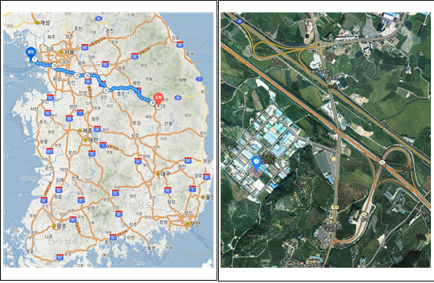
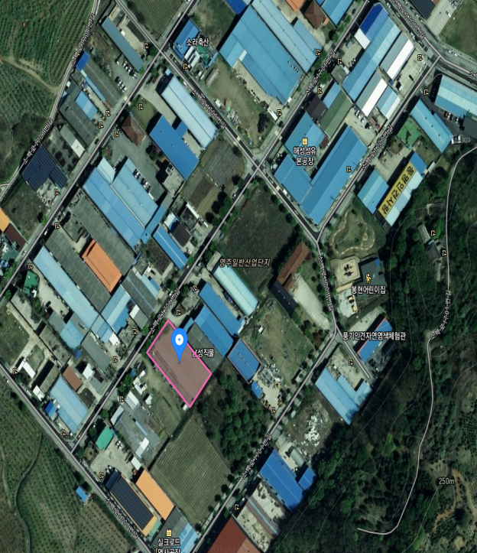
3. Funds for Factory Construction and Equipment
Land for Red Ginseng Concentrate Extract Factory
*Location of the land: In the vicinity of Punggi-town, Yeongju-city, Gyeongbuk
(Origin of Ginseng)
*Strength of the location: As the origin of Ginseng, easy to buy Ginseng/
Red Ginseng and many professional [Ginseng/Red Ginseng workforce]
◎Land for Factory for Red Ginseng Concentrate Extract
1)Location: 417-8, Daechon-village, Bonghyeon-town, Yeongju-city, Gyeongbuk
Province: Food Manufacturing
2) Size of the land: 1,649m2
3) Price of the land: $462,832USD (Tax included)
4) Seller of the land: Mr. Yoon, Yong-chae
5) This land is located in the Punggi Ginseng Industrial Complex, famous for
Ginseng/Viscose Rayon.
[Location Map, 235 kilometers, 2 hours and 50mintues from Incheon Int’l Airport to Yeongju-city]
1
INHYANG CORPORATION
Made in Korea

Slide 22
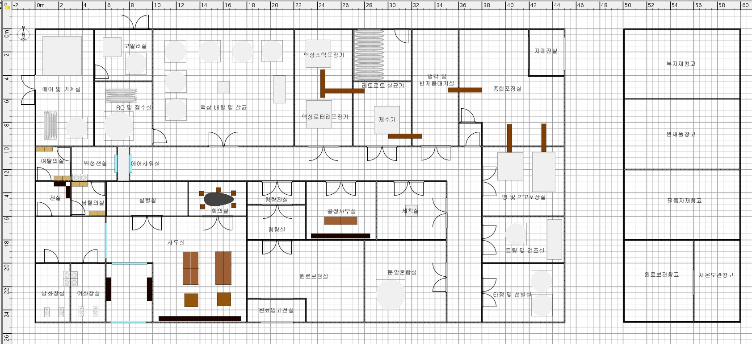
(Expenses of Construction and each factory)
Factory for extract of Red Ginseng Concentrate
[Construction]
○ Design of factory for concentration (Floor Plan meets the HACCP, GMP
requirements)
Main Process Line: Extract/Concentrate Line, Liquid Stick Line, Liquid
Pouch Line, Tableting Line
(Tableting line will be installed when space is secured)
○ Factory for extract of Red Ginseng Concentrate
[1,652.9m2 X $1,338.5/m2 = ＄2,212,389 (Cost)
*Expenses of Design & Authorization/Permit =$88,496
1
ⓠ
ⓤ
INHYANG CORPORATION
ⓡ
ⓢ
ⓣ
⑪
ⓝ
ⓞ
⑩
ⓟ
⑨
⑦
ⓘ
ⓙ
⑧
ⓖ
⑤
⑥
ⓗ
④
ⓔ
ⓕ
ⓜ
⑭
ⓓ
②
③
ⓑ
ⓒ
⑬
ⓐ
ⓛ
①
⑫
⑮
ⓚ
Made in Korea

Slide 23
1
Drawing explanatory data
①Air and Machine Room(에어 및 기계실)
②Boiler (보일러실)
③Reverse Osmosis & Water Purification ( RO 및 정수실)
④Liquid Blending and Sterilization (액상배합 및 살균 )
⑤Liquid Stick Packing (액상스틱 포장기)
⑥Rotary Liquid Packing(액상 로터리 포장기)
⑦Retort Sterilization Equipment(레토르트 살균기)
⑧Water Remover(제수기)
⑨Storage for Cooling and Semi-finished Products (냉각 및 반제품 대기)
⑩Comprehensive Packing(종합 포장실)
⑪Room for various materials(자재전실)
⑫Female Changing Room(여탈의실)
⑬Sanitation Room(위생전실)
⑭Air Shower Room(에어샤워실)
⑮Front Room(전실)
ⓐMale Changing Room(남탈의실)
ⓑLaboratory(실험실)
ⓒOffice(사무실)
ⓓMeeting Room (회의실)
ⓔFront room of Weighing Room(칭량전실)
ⓕWeighing Room(칭량실)
ⓖOffice(공정사무실)
ⓗRaw Material Storage (원료보관실)
ⓘWashing Room(세척실)
ⓙPowder Mixing room(분말혼합실)
ⓚMale Toilet(남자 화장실)
ⓛFemale Toilet(여자 화장실)
ⓜRaw Material Receiving Room(원료입고 전실)
ⓝBottle and PTP Packing Room(병 및 PTP 포장실)
ⓞCoating and Drying Room(코팅 및 건조실)
ⓟTableting and Selecting Room(타정 및 선별실)
ⓠ부자재창고: Subsidiary Material Warehouse
ⓡWarehouse for Finished Products(완제(재)품 창고)
ⓢFilm Storage Warehouse(필름자재창고)
ⓣRaw Material Storage Warehouse(원료보관창고)
ⓤLow-temperature Storage Warehouse(저온보관창고)
INHYANG CORPORATION
Made in Korea

Slide 24
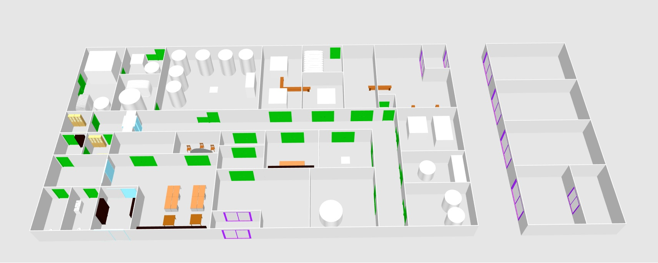
internal stereoscopic plane drawing
INHYANG CORPORATION
Made in Korea

Slide 25
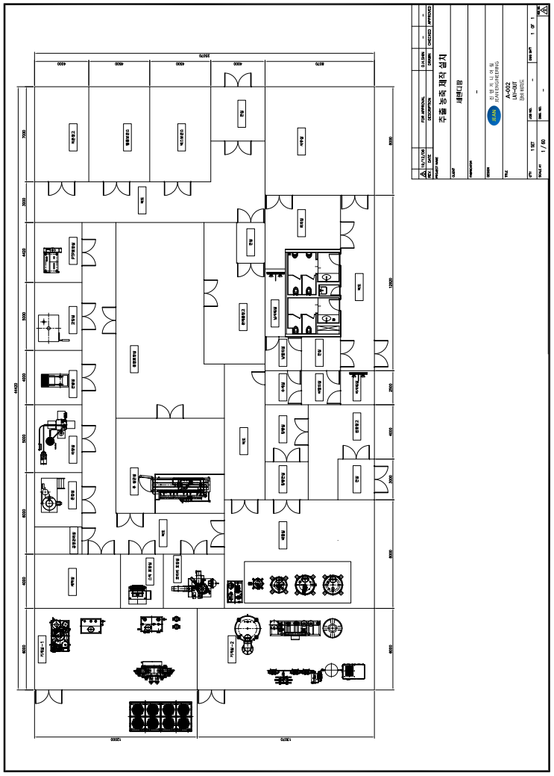
Design of Red Ginseng Concentration Factory (Planar Plan)
INHYANG CORPORATION
Made in Korea

Slide 26
[Details of Machinery and Equipment Costs]
(Amount Costs : $2,426,249) (VAT included)
1
No. | Category | Name of Item | Amount (USD) (VAT Excluded) | Specification/Purpose | Note
1 | Packaging Machine | Air Steam Retort Sterilization Equipment | 145,062 | Maximum Working Pressure and Temperature: 2.0kg/㎠,125℃ | Gyeong-Han Inc.
2 |  | Automatic Liquid Stick Pack Machine | 108,407 | Model : HLQ-P3V, 5열 | Han-Dok Inc.
3 |  | Automatic Liquid Filling Machine | 125,664 | Model : HR-600 | Han-Dok Inc.
4 | Manufacturing Machine | Mixing/CIP Equipment | 166,372 | Mixing Tanks (300/1000/2000Lit) CIP Tank, Transfer Pump, Ultra High Temperature (UHT) Instant Sterilizer | Amount
 | UHT | UHT | 88,496 | UHT Instant Sterilizer | Amount
 | Extraction & Concentration | Extractor & Concentrator | 530,973 | Extractor/Concentrator | Amount
5 | Electric Switchboard | Automatic Switchboard for Machines | 61,947 | Electric Switchboard for Manufacturing Machines, Electrical Work, and various meters | cost
6 | Incoming Panel | Incoming Panel for whole factory | 53,097 |  | Cost
7 | Pipe and Utility | Pipe and Utility | 168,142 | Pipe lagging, Worktable | Cost
8 | Freezer |  | 70,796 | 80RT-Detachable Pump, Tank included | Bum-Yang Inc.
9 | AIR Compressor |  | 72,566 | 50hp-dryer, Filter included | Han-Shin Inc.
10 | Boiler |  | 60,177 | 2ton-LNG-Once Through Boiler-Condensate Tank | Booster Inc.
11 | Air Handling Unit |  | 88,496 | Cooling/Heating/Dehumidification | Cost
12 | Sanitary Equipment |  | 8,850 | Various Sanitary Equipment | Cost
INHYANG CORPORATION
Made in Korea

Slide 27
13 | Forklift |  | 39,823 | Electric Forklift, 1.5 ton Lift | Cost
14 | Warehouse Rack |  | 13,274 | Fixed Rack for Raw Material Storage | Cost
15 | Lab Equipment |  | 44,248 | General Experiment, Microbial Test, Specification of Items | Cost
16 | Metal Detector |  | 13,274 | Fixed Metal Detection | Cost
17 | Checkweighers |  | 13,274 | Fixed Weight Measure | Cost
18 | Marking Machine for printing Expiration Date |  | 8,850 | Marking for Expiration Date and Product Number | Cost
19 | Pallet(For Indoor Use) |  | 3,540 | Pallets for Indoor Storage of Raw Material | Cost
20 | Scale for raw material measuring |  | 1,770 | Scale for Raw Material Measure | Cost
21 | Stainless Steel Baskets |  | 2,212 | For Transporting of Raw Material | Cost
22 | Water Remover |  | 39,823 | Remove Water After Liquid Product Sterilization | Cost
23 | Hand lift |  | 1,327 | For Transporting Raw Material and Subsidiary | Cost
24 | Stainless Moving Cart |  | 885 | To move small amount of raw material | Cost
25 | Reverse Osmosis Equipment |  | 97,345 | 1㎥/hr-Tank, Pump included | Cost
 | Other Utilities |  | 176,991 | Other Utilities | Cost
Total (USD) |  |  | 2,205,681 | VAT Excluded
INHYANG CORPORATION
Made in Korea

Slide 28
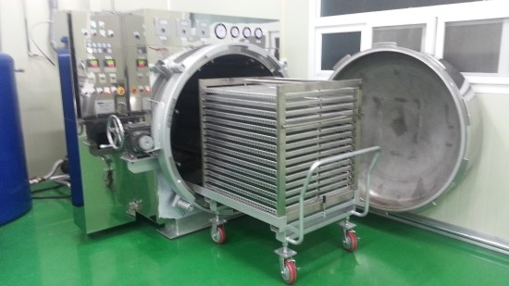
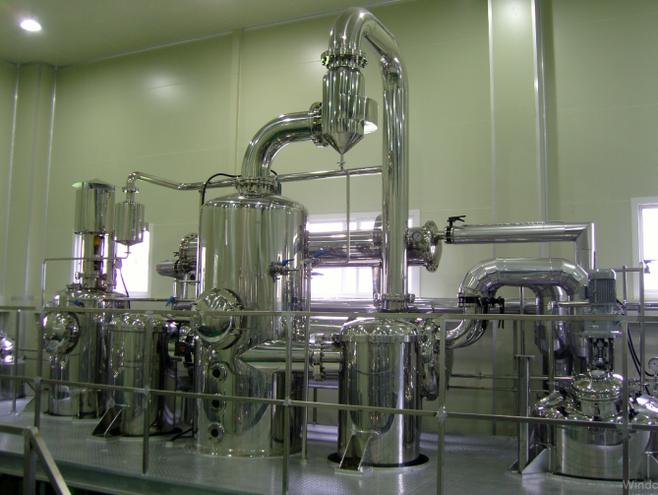
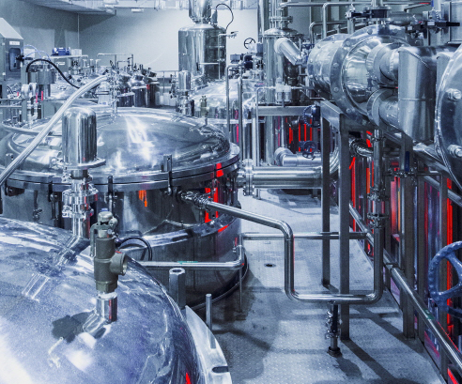
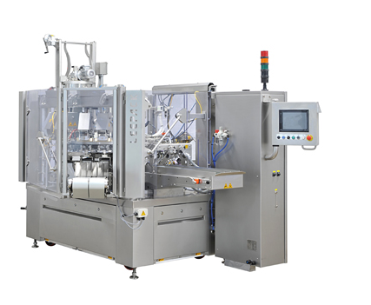
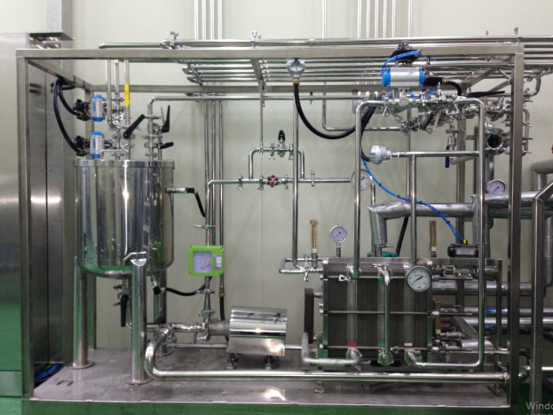
※ Red Ginseng Concentrate Machine ,etc
Air Steam Retort Sterilization
Equipment
INHYANG CORPORATION
4. Manufacturing Machine
4. Extraction Concentration
1-3. Packaging Machine
7. Pipe and Utility
Made in Korea

Slide 29
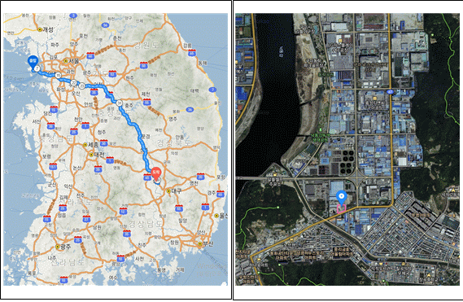
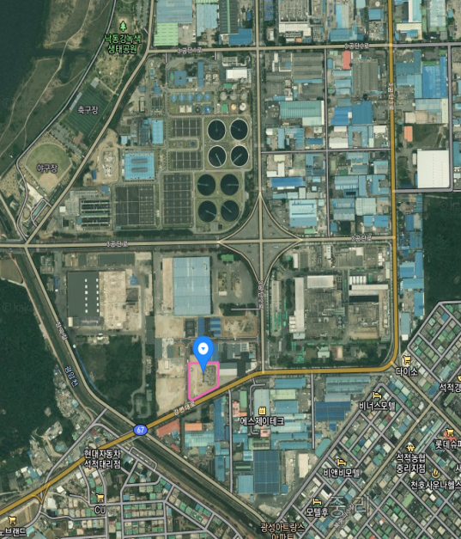
Land for Red Ginseng Concentrate Filling and
Container Development Factory
◎ Land for Factory for Manufacturing Food including Filling Facility
1) Location: 443-12, Joong village, Seokjeok-town, Chilgok County,
Gyeongbuk
2) Size of the land: 3,311m2
3) Price of the land: $1,156,500USD (Tax included)
4) Seller of the land: Star Chemical
5) This site is located in the Gumi3 Industrial Complex, Chilgok County
and the investment value is high because the Gunwi County, near
from the Chilgok County, was recently selected as a site of the new
airport which will be relocated from Daegu Metropolitan City.
[Location Map, 250 kilometers, 3 hours from Incheon Int’l Airport to Chilgok
County]
2
INHYANG CORPORATION
Made in Korea

Slide 30
(Expenses of Construction and each factory)
Factory for filling [Construction]
* Factory for Filling
[991.74m2 X $1,338.5/m2 = ＄1,327,434 (Estimated Cost)
* Costs of Design and Authorization/Permit: $88,496 (USD)
2
2
Expenses of Cap and Blister Filling Machine [＄2,123,017]
(Amount Costs) / (VAT included)
No. | Category | Name of Items | Amount (USD) (VAT Excluded) | Specification/Purpose | Note
1 | Packaging Machine | Pop Cap Filling Machine | 353,982 | Maximum Working Pressure and Temperature: 2.0kg/㎠,125℃ | Gyeong-Han Inc.
2 |  | Blister Filling Machine | 353,982 | Model: HLQ-P3V | Han-Dok Inc.
3 |  | GMP Facility and Basic Packaging Line | 132,743 | Model: HR-600 | Han-Dok Inc.
4 | UHT | UHT | 88,496 | UHT | Cost
5 | Electric Switchboard | Automatic Switchboard for Machines | 61,947 | Electric Switchboard for Manufacturing Machines, Electrical Work, and various meters | Cost
6 | Incoming Panel | Incoming Panel for whole factory | 53,097 |  | Cost
7 | Pipe and Utility | Pipe and Utility | 168,142 | Pipe lagging, Worktable | Cost
8 | Freezer |  | 70,796 | 80RT- Detachable Pump, Tank included | Bum-Yang Inc.
9 | AIR Compressor |  | 72,566 | 50hp-dryer, Filter included | Han-Shin Inc.
10 | Boiler |  | 60,177 | 2ton-LNG- Once Through Boiler-Condensate Tank | Booster Inc.
11 | Air Handling Unit |  | 88,496 | Cooling/Heating/Dehumidification | Cost
12 | Sanitary Equipment |  | 8,850 | Various Sanitary Equipment | Cost
13 | Forklift |  | 39,823 | Electric Forklift, 1.5 ton Lift | Cost
14 | Warehouse Rack |  | 13,274 | Fixed Rack for Raw Material Storage | Cost
15 | Lab Equipment |  | 44,248 | General Experiment, Microbial Test, Specification of Items | Cost
INHYANG CORPORATION
Made in Korea

Slide 31
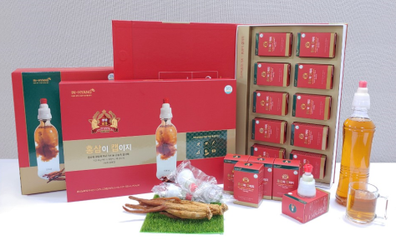
16 | Metal Detector |  | 13,274 | Fixed Metal Detection | Cost
17 | Checkweighers |  | 13,274 | Fixed Weight Measure | Cost
18 | Marking Machine for printing Expiration Date |  | 8,850 | Marking for Expiration Date and Product Number | Cost
19 | Pallet(For Indoor Use) |  | 3,540 | Pallets for Indoor Storage of Raw Material | Cost
20 | Scale for raw material measuring |  | 1,770 | Scale for Raw Material Measure | Cost
21 | Stainless Steel Baskets |  | 2,212 | For Transporting of Raw Material | Cost
23 | Hand lift |  | 1,327 | For Transporting Raw Material and Subsidiary | Cost
24 | Stainless Moving Cart |  | 885 | To move small amount of raw material | Cost
25 | Reverse Osmosis Equipment |  | 97,345 | 1㎥/hr- Tank, Pump included | Cost
26 | Other Utilities |  | 176,991 | Other Utilities | Cost
Total (USD) |  |  | 1,930,088 | VAT Excluded
INHYANG CORPORATION
※ Types of Facility Equipment ♣ Red Ginseng “Cap” Filling Equipment
Made in Korea

Slide 32
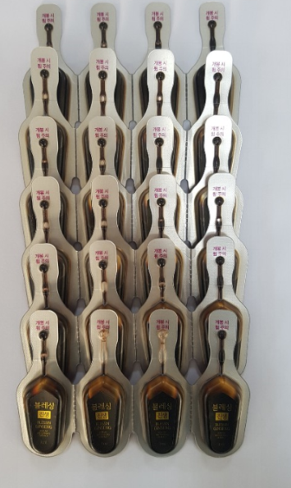
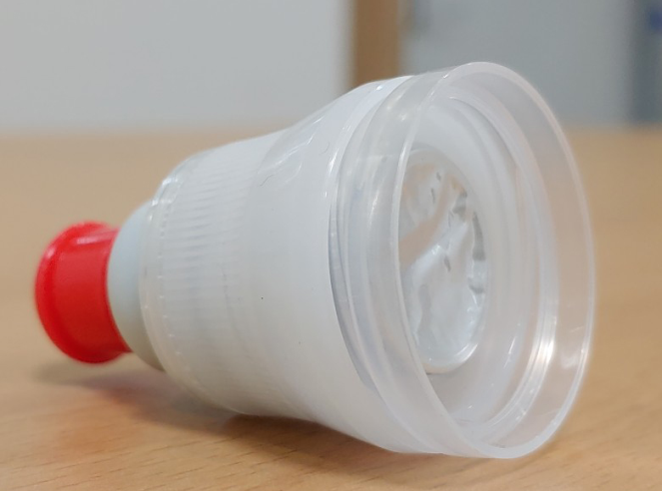
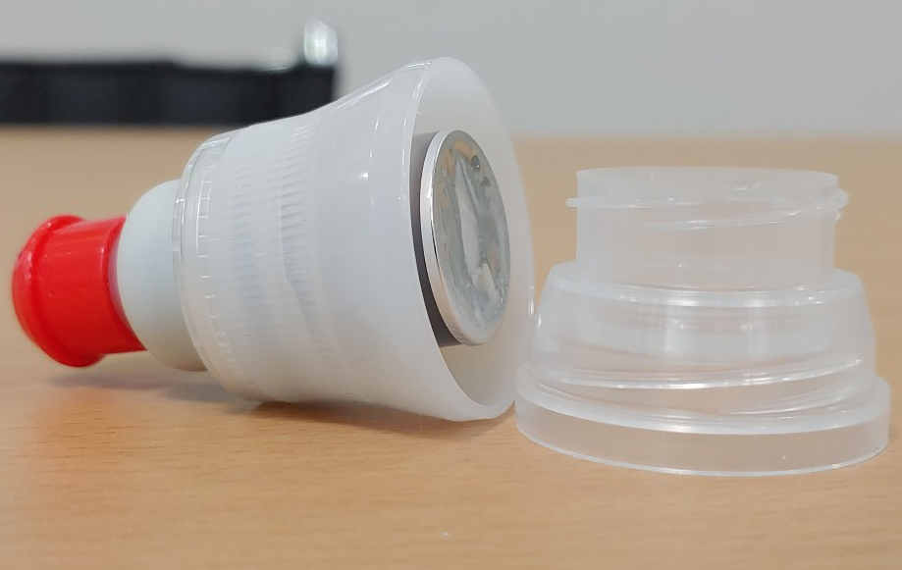
Red ginseng “CAP Container ” Picture
INHYANG CORPORATION
Red ginseng “Blister : Cheers” Picture
①
②
Red ginseng “CAP Container ” ① World-Wide foreign bottle cap
② Korea bottle cap
[double socket : Manual reference ]
Made in Korea

Slide 33
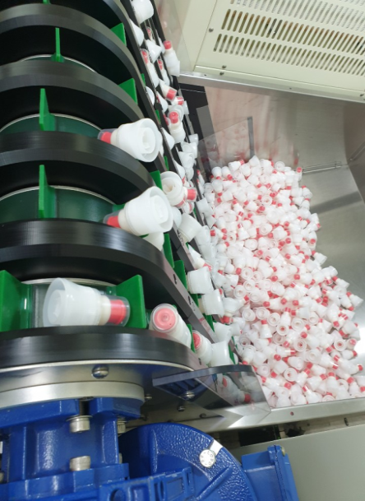
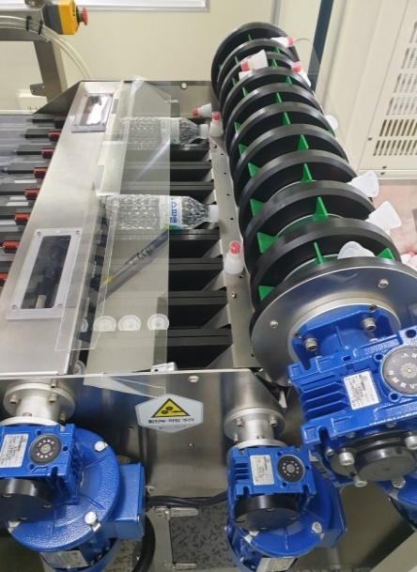
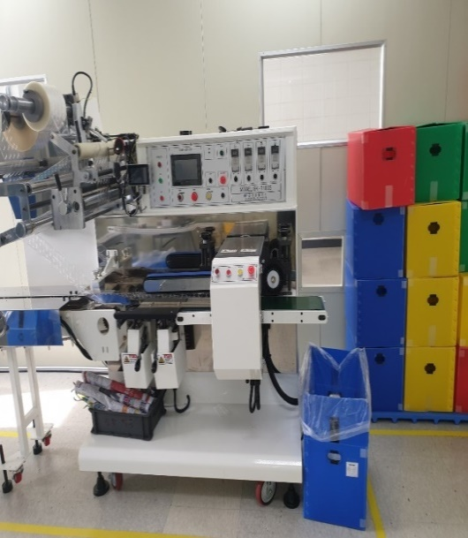
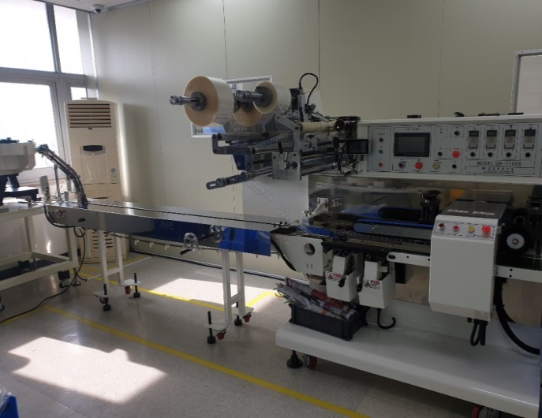
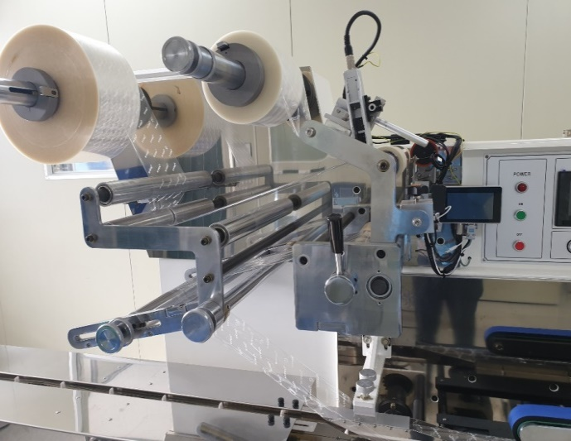
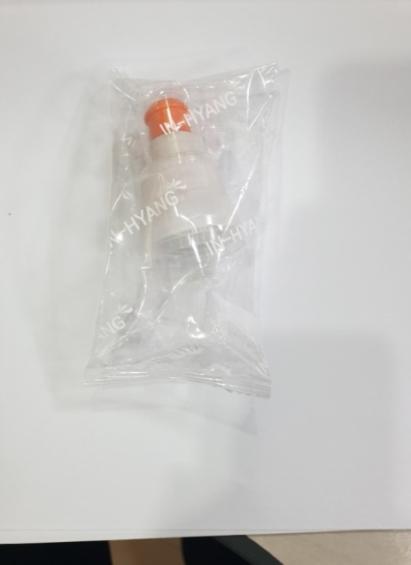
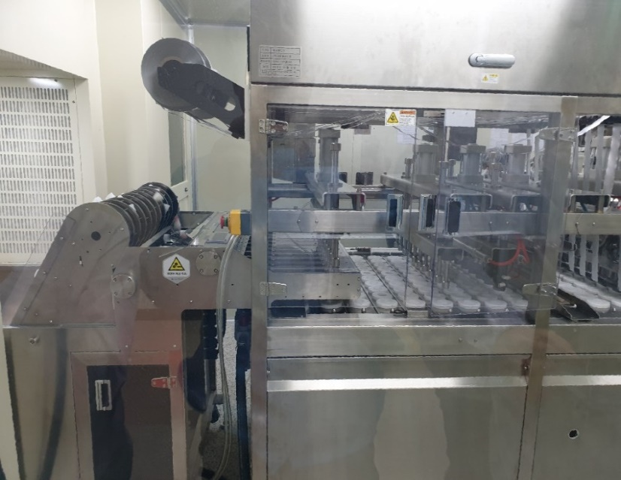
Production Process of INHYANG “Red Ginseng Cap” (Photo)
INHYANG CORPORATION
Made in Korea

Slide 34
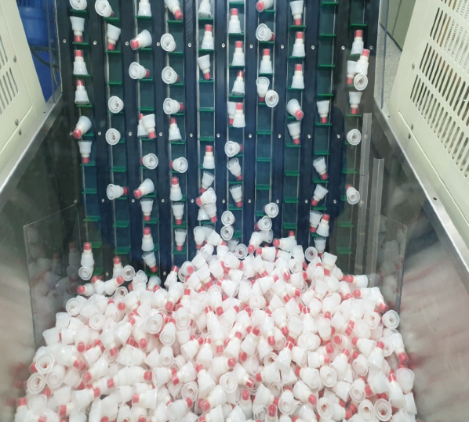
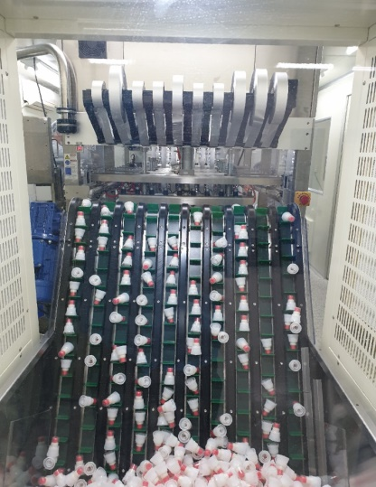
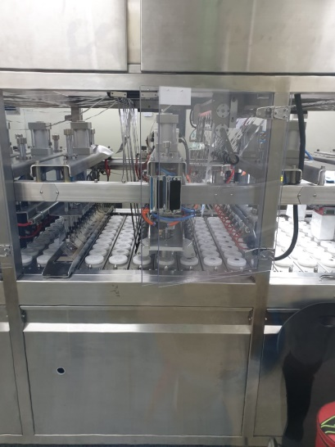





Production Process of INHYANG “Red Ginseng Cap” (Photo)
INHYANG CORPORATION
Made in Korea

Slide 35


Land for products’ container development factory
1)Location: 808, Agok-village, Waegwan-town, Chilgok County, Gyoengbuk
2)Size of the land: 3,333.6m2
3)Price of the land purchase: $1,018,230USD (Tax included)
4)Seller of the land: Younghwa Corp.
[Current price of the land: $1,415,929USD (Tax included)]
5)This site is an industrial complex which was established by the assistance
of government’s fund and if sold within 5 years, the selling price is
significantly low due to the control of Chilgok County.
[Location Map, 250 kilometers, 3 hours from Incheon Int’l Airport to Chilgok
County]
3
INHYANG CORPORATION
Made in Korea

Slide 36
Factory for Container Development [Construction]
* Factory for Filling
[661.16m2 X $1,151.4/m2 = ＄761,062
* Costs of Design and Authorization/Permit: $88,496 (USD)
3
3
Expenses of Cap and Blister Filling Machine [＄973,452]
1. Load Shelf | 2. Toolbox | 3. Working Platform
4. Height Adjustable/ General Work bench | 5. Shock Resistant Floor | 6. Mobile Electric Cord Reel
7. Automatic Electric Shock Prevention Device | 8. Overload Protection Device | 9. Moving Cart
10. Welding Device Carrier | 11. Auxiliary Heavy Equipment Carrier | 12. Automatic Lifting
13. Scissor Lift | 14. Press Automation Equipment | 15. Local Exhaust Ventilation (Mass Production)
16. Industrial Floor Vacuum Cleaner | 17. Machinery Moving Equipment | 18. Conveyor System
19. Mold Change System | 20. Automated Injection Molding Machine | 21. DC Arc Welding Machine
22. Chip Shatterproof Barrier | 23. Hazardous Beam Protection Barrier | 24. Noise Reduction Earmuffs
25. Lock | 26.Mobile Ladder | 27. Hopper Loader
28. Desk Drill | 29. Portable Air Cooler | 28. Other Accessories
INHYANG CORPORATION
Made in Korea

Slide 37


3
Container development manufacturing mold and injection process diagram
process diagram [1]
production plan
2D Design
product design
frame work
CAM work
milling
CNC work
INHYANG CORPORATION
base completion
discharge work
core+base coupling
core completion
process diagram [2]
material supply
dryness
molding
Press
finished product
Package (delivery)
crushing (disposal)
Made in Korea

Slide 38








⊙ Container development equipment for company products
Red ginseng “CAP” Container
Red ginseng “Bottle” Container [the tube container having no the remaining amount]
Red ginseng “Blister” Container , etc
INHYANG CORPORATION
Made in Korea

Slide 39



4. [Explannation]
☞In Sam(ginseng) and
☞Hong Sam(Red ginseng) and
☞Concentrate of Red ginseng
☞In Sam(ginseng)
INHYANG CORPORATION
☞ Hong Sam
(Red ginseng)
steam ginseng nine times and
Dried ginseng nine times
=> Red Ginseng
☞Concentrate of
(Red ginseng)
Made in Korea

Slide 40
5. Plan to purchase of raw materials or
concentrate of Red Ginseng
[Red Ginseng Purchase Fund (Purchase in advance): $10,000,000USD]
Total Required Fund | $10,000,000USD | $10,000,000USD | Note
Purchas items | 6-year-old Red Ginseng for raw materials ($134/kg) | Concentrate of 6-year-old- Red Ginseng ($161/kg) | Without exchange rate fluctuation, raw material of Red Ginseng can be purchased with the above amount.
Quantity of purchase | 75-ton | 62-ton
Cost of Red Ginseng Extract | $27/kg (Possible price change) | 0 N/A
Quantity of Red Ginseng Concentrate |  | 62,7kg (약62톤)
INHYANG CORPORATION
The above shows the amount of Red Ginseng or Red Ginseng concentrate which can be purchased with $10,000,000USD.
Raw red ginseng requires an extra cost for extraction and concentration.
The raw material red ginseng is “6-year-old ginseng” and meets the
standard confirmed by the “National Verification Agency”.
It’s advantageous to purchase immediately after extraction of the concentrate of Red Ginseng
(There are sufficient markets selling the concentrate of the(Red ginseng).
Made in Korea

Slide 41



◆ The role of “Local Ginseng Agricultural Cooperative Federation (LGACF)”
(LGACF is one of branches of South Korean cooperative federation also
known by its Korean initials NH, Nong Hyup)
Ginseng growers’ report stating their cultivation is computerized and kept by
the LGACF. (When cultivating Ginseng, all Ginseng growers must report their
cultivation to LGACF in order to be certified root age and grade of the Ginseng. If
Ginseng growers don’t register their cultivation to LGACF, those Ginseng won’t be
sold in a good price because unregistered Ginseng can’t be certified the age of
Ginseng roots. Therefore, most of Ginseng growers report their cultivation to LGACF,
and buyers tend to check the certificate of the age of Ginseng roots issued by
LGACF even in general transactions.
2. The LGACF manages field testing and inspection of Ginseng farms and inspects
pesticide residues
3. The LGACF purchases general Ginseng from the growers to produce processed
products.
◆ The current status of LGACF
3 LGACFs (Punggi, Geumsan, Gangwon) are the most representative
organizations and Punggi LGACF is considered as the best one in terms of history
and system.
◆ Ginseng Industry Act
Ginseng Industry Act has a separate legal basis, and LGACFs manage root
age of Ginseng, test, certification.
INHYANG CORPORATION
◆ Manufacturing Process of Red Ginseng
Washing: It’s a process of washing dirt cleanly. Once the first
washing is finished with high-pressure clean water in the
Ginseng washing machine, the microscopic vibration of the
ultrasonic Ginseng cleaner removes all the remaining dirt in
the gap between Ginseng.
2. Steaming: Washed Ginseng is steamed in the steaming
machine and the color of red ginseng gradually is made during
the process of steaming.
3. Sun drying: Steamed Ginseng will be dried using the traditional
way of sunlight and wind for about 15 days.
Made in Korea

Slide 42





4. Shaping: The shape of Red Ginseng is made by the process of
shaping. Prior to shaping, thin roots and branches attached to
the main roots are removed and the shape of Red Ginseng is
finally made through shaping.
5. Selection: The shaped Red Ginseng is classified through three
stages of Red Ginseng’s internal structure, weight, and
appearance such color, crack, shape and divided into root
ginseng suitable for the grade.
6. Compression: Selected Red Ginseng is compressed by the
compression machine for packaging.
INHYANG CORPORATION
7. Packing: After packaging in a wooden box which Hanji (Korean traditional paper) is laid and packed again in a plastic film in the form of wooden box, and vacuum-packed, and finally put in a can.
◆ Ginseng and Red Ginseng consumption by use per a LGACF
Made in Korea

Slide 43

◆ Amount of Ginseng and red ginseng consumption per a LGACF
INHYANG CORPORATION
◆ Securing Red Ginseng and Ginseng that clearly show the origin and root age
confirmation is made through or direct purchase.
Therefore, there is no problem in purchasing raw materials with confirmed origin
and root age through a contract with individual LGACF
COVID-19 : preventive effect
◆ In the process of steaming to the red ginseng, the toxins of the raw ginseng
(Ginseng) are removed.
◆ Red ginseng contains saponin (ginsenoside), amino acids, antioxidants,
maltol, and organic fatty acids, making it the best product for overcoming
covid-19 (improvement of immunity).
◆ Red ginseng is a traditional Korean medicine that has already been loved by
the people for 2,000 years.
◆ Red ginseng concentrates are health functional foods made by concentrating
these red ginseng and are well promoted all over the world (World – Wide)
◆ Red ginseng concentrate is the representative food of Korea that the
president of Korea presents most to foreign presidents
Made in Korea

Slide 44
6. R & D Contents
Concentrate | Cost of Research | Cost of Research Institute | Patent Registration Fee (Incidental cost included) | Total
Cost of 3 Red Ginseng Concentrate Patent Registration | Development is completed |  | ＄88,495 | ＄88,495 (Overseas is included)
Cost of 3 fermented concentrate research | ＄53,097 | ＄88,495 | ＄35,398 | ＄176,991
Types of containers | Cost of Design (Outsourcing) | Cost of Molding (Outsourcing) | Patent Registration Fee (Incidental cost included) | Total
Cap(Push Pull type) | ＄8,850 | ＄44,247 | ＄8,850 | ＄61,947
Cap(Lid type) | ＄8,850 | ＄44,247 | ＄8,850 | ＄61,947
Blister | ＄8,850 | ＄44,247 | ＄8,850 | ＄61,947
No-leftover Tube Container | ＄8,850 | ＄44,247 | ＄8,850 | ＄61,947
총계 | ＄88,495 | ＄265,483 | ＄159,292 | ＄513,274
INHYANG CORPORATION
Made in Korea

Slide 45
7. Comparison of competitiveness between existing
products and our products
Category | Existing Products(KGC included) | IN HYANG’s products | Feature of IN HYANG’s products
Type of Containers | Pouch/Stick/Glass Bottle | Cap/Blister/No-leftover Tube container | Acquisition of Monopoly for containers
Raw Material of Red Ginseng | Mixed 4/5/6year Ginseng root and various herbal medicines (Only KGC uses 6-year-old Red Ginseng) | IN HYANG uses only 100% 6-year-old Red Ginseng (IN HYANG purchases Red Ginseng only at National Ginseng NH, Quality Assurance Organization) | Safety Guarantee
Product competitiveness compared to the same price | Concentrate 150ml (2-3 pouches of Red Ginseng Concentrate) | Concentrate 500ml (1 Red Ginseng Cap | Less than 50% of the price of KGC products
Weight | Very heavy | Very light | 1/5 weight than KGC
On board of Airplane | Banned | Allowed | Allowed in carry-on bags
Solvency in water | Need to stir or shake more than 30 seconds | Completely Soluble in 2 seconds | Keep Fresh
Taste | Slightly Sweet (Other herbal medicines added) | Slightly Bitter (100% Red Ginseng) | 100% Genuine Red Ginseng
Shelf Life | 2 years | 2 years
Production volumes | Mass production (Currently) | *Small Quantity Production (Currently) *Mass production will be available once construction of facilities is completed | Mass production will be available after investment of the new facilities
Development of the new product | *Raw material development and Change (s/w) | *Raw material development and Change(s/w) *Development of Container and Change(h/w) | Development of the new product will be available after investment of the new facilities
Brand Awareness | High | Low (Brand Awareness will be increased if advertised) | Brand Awareness will be increased if advertised
Facility Assurance | HACCP(Certified) GMP(Good Manufacturing Practice | HACCP(Certified) GMP(Good Manufacturing Practice
Quality Assurance | 100 Million KRW Liability Insurance for products | 100 Million KRW Liability Insurance for products | Same
INHYANG CORPORATION
Made in Korea

Slide 46

■ Business Market
A. Pro Forma Financial Statement [Enclosure]
B. Size of Red Ginseng Market, Annual Average Growth Rate: 6%
C. Sales example of KGC
INHYANG CORPORATION
D. Scale of Market Growth (Year 2022)
Item | Scale of Market Growth, Year 2022 (USD/$)
Red Ginseng (Root) | Export | $1,106,194,690
 | Domestic | $1,769,911,504
 | Total | $2,876,106,194
Red Ginseng(Product) | Export | $2,212,389,380
 | Domestic | $3,539,823,008
 | Total | $5,752,212,389
※KGC’s current market share rate: 70% (Almost Korean Red Ginseng Monopoly)
※It’s difficult for us to share Red Ginseng market with the same types of products of KGC
but we’re very competitive with the special and sensational Red Ginseng products.
(Types of existing Red Ginseng Products: Pouch, Stick, Glass Bottle)
Made in Korea

Slide 47
8. Sales Plan
(When self-mass production facilities are completed)
Category | Now | After | Note
Domestic Sales | Mail Order | ·Infomercial Channel (four times/a month) (400,000 units will be sold per a month) | When mass production is available
 | Internet Sales | ·Build our own website for sales | When mass production is available
 | Market Sales (Waegwan NH Hanaro Mart) | Sales at 2,800 NH Hanaro Mart would be possible (INHYANG’s products were registered to NH) Plant to provide 100units to each Hanaro Mart/Month (Possible to provide 280,000 units to Hanaro Mart nationwide) ·e-mart (the largest retailer in S. Korea) | Contract of demonstration store was completed
 | Sales for group | ·Korea Cycle Federation ·Korea Golf Association ·Korea Alpine Fedeeration ·Korea Baseball Organization ·Korea Basketball Association ·Korea Football Association ·Promotion at the housing sales market | Available when facilities for the mass production is completed (through Advertisement)
Subtotal | Lack of funds Lack of the Company’s own facilities (Short of production) | Possible to sell 1,000,000units/month
Overseas Sales (Export) | N/A(Due to COVID-19) | 27countries available (Plan to use the Punggi Ginseng NH’s overseas sales network managed by Yeongju-city | Yeongju-city’s sales network invested by ROK Governement was established
 | Open Branch Offices | (America) Korean Association of Los Angeles (South Asia) Singapore Japan Tokyo China Shanghai Europe Sweden South America Brazil Dubai Expo Tokyo Olympic | Year 2022
 | Internet Sales | In Open market (Alibaba in China etc) (Amazon in USA etc) | Year 2022
Subtotal | Lack of funds Lack of the Company’s own facilities (Short of production) | Possible to sell 1,000,000 units/month
INHYANG CORPORATION
Made in Korea

Slide 48
9. List of Enclosures
1)Articles of Association
2)Pro Forma Financial Statement
3)Diagram of Fund Guarantee and Execution
INHYANG CORPORATION
Made in Korea

Slide 49

10. Product Manual of “Redginseng CAP”
1)Articles of Association
2)Pro Forma Financial Statement
3)Diagram of Fund Guarantee and Execution
INHYANG CORPORATION
Made in Korea

